Slide 1

Combinational Logic Circuits Design
CMPE243-S02 Logic Circuit Design
Midterm Project
Project Supervisor: Assoc. Prof. Dr. Nima Jafari Navimipour
Group-2
Team Members
Zeynep Nisa Kaya (CMPE)
Sıla Kılınç (CMPE)
Şimal Ersuz (CMPE)

Slide 2
Project Goals
Automating the Bus ID → Stop Code conversion
Creating efficient design with Boolean simplification
Validating the design with simulation/CADET system application

Slide 3
Design & Implementation
Model
Creating the truth tables
Extracting the minterms
Defining 4-bit input and 4-bit output functions
Design
Preparing K-maps for each output
Simplifying Boolean expressions by Sum of Product method
Obtaining minimal equations for Y₃–Y₀
Implementation
Testing the simplified equations in Simulink
Building the circuit on CADET with 7404 (NOT), 7408 (AND), 7432 (OR) Ics
Observing Y₀–Y₃ outputs with LEDs
3/9

Slide 4
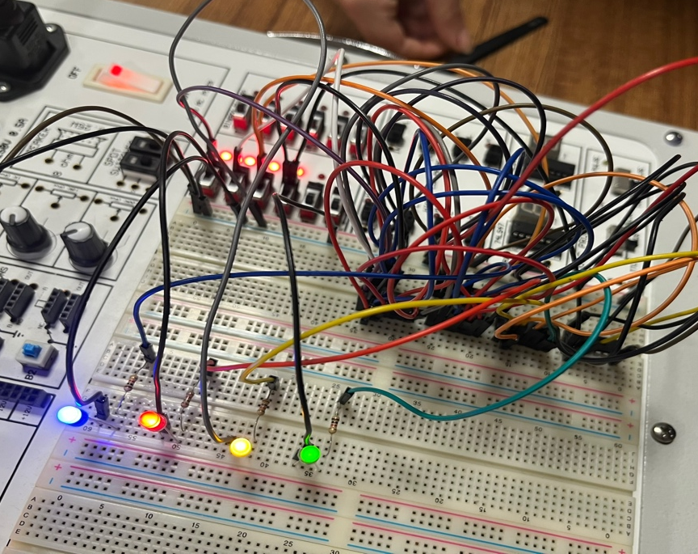
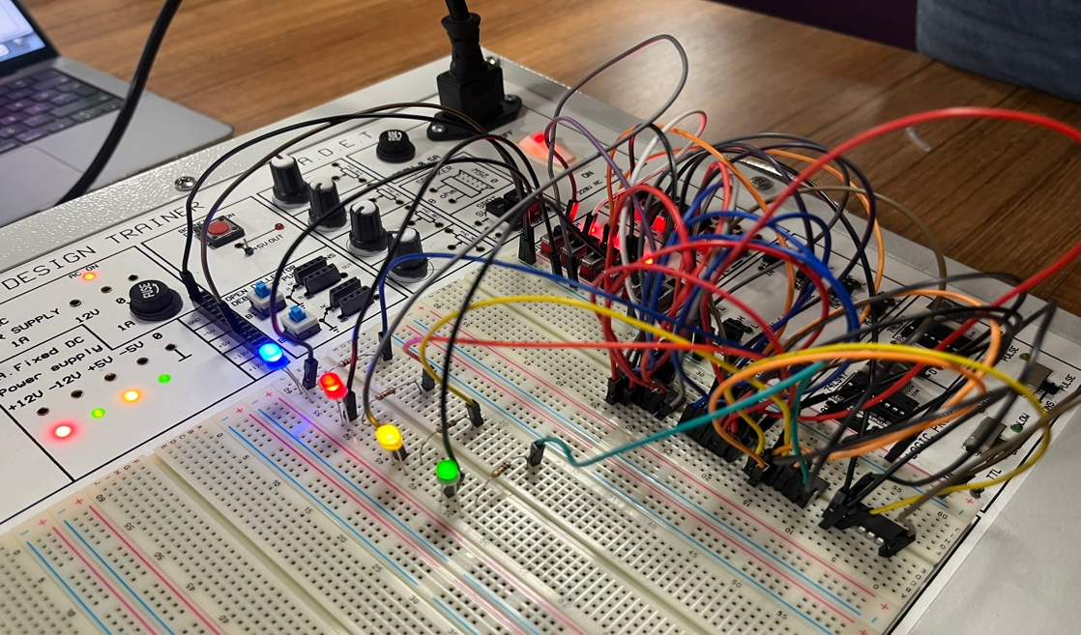
Design & Implementation
Figure-1 CADET system application
Figure-2 CADET system application

Slide 5
Key Points
Simulink–CADET results are fully compatible
Creating an efficient circuit that operates with minimal gate count
Generating correct stop codes for all 16 input combinations

Slide 6
Main Findings
K-Map simplification reducing the number of gates
LED outputs in the CADET system matching the stop-codes
The correct Boolean functions (Y₃–Y₀) were obtained using K-map analysis and simplification.

Slide 7
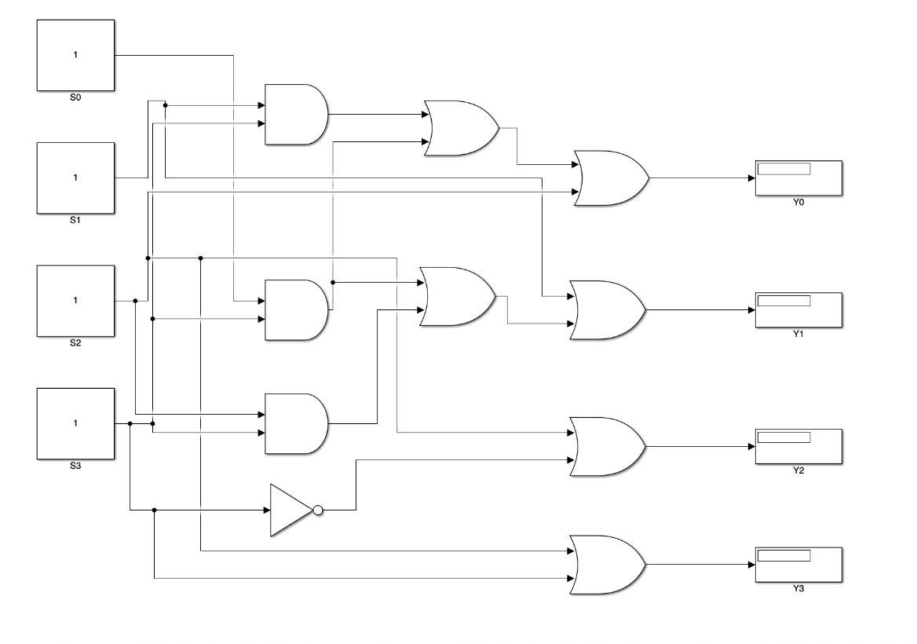
Main Findings
Table-1 K-Map of output Y₃
S₁S₀ S₃S₂ | 00 | 01 | 11 | 10
00 | 0 | 0 | 0 | 0
01 | 1 | 1 | 1 | 1
11 | 1 | 1 | 1 | 1
10 | 1 | 1 | 1 | 1
Figure-3 Overall Simulink Model

Slide 8
Conclusion
Gate numbers was decreased achieved through K-map simplification
(1 AND, 1 NOT, 2 OR)
Full functional compatibility between the Simulink model and the CADET application has been verified.
The design provides a basic module that can be integrated into larger routing systems.
The circuit achieved its planned function quickly, decisively, and reliably.

Slide 9
References
[1] M. M. Mano and M. D. Ciletti, Digital Design, 4th ed. Upper Saddle River, NJ: Pearson Prentice Hall, 2007.
[2] C. H. Roth, Jr., L. L. Kinney, and E. B. John, Fundamentals of Logic Design, 7th ed. Cengage Learning, 2021.

